Slide 1

Cloud native technology journey

Slide 2

Cloud native is the new paradigm of software development
35
>
%
of all production apps will be cloud-native by 2022¹
¹IDC FutureScape, 2018
Notes:
SPEAKER: New paradigm of application development
The rapid rise of new digitally native businesses have disrupted traditional business models and destabilized established companies and industry sectors. The grounds for competition have changed – enterprises are increasingly defined by the way they build software. Challenger banks, online healthcare providers, e-commerce leaders and other upstarts are winning customers by providing new applications.
All these trends have yielded a new paradigm of software development called cloud native.
IDC predicts by 2022, 35% of all production apps will be cloud-native vs. less than 10% today
IDC: https://www.idc.com/getdoc.jsp?containerId=prUS44417618

Slide 3

What
is
cloud native
?
Package application code & dependencies in containers, deploy as microservices and manage them using DevOps processes & tools
APIs
Expose services as light-weight APIs for easier integration
Containers
Standard deployment format to abstract code from underlying infrastructure differences
Microservices
Architectural approach to developing an application as a collection of modular, loosely coupled services
DevOps
People, processes and technology that promote collaborative building and delivery
Notes:
SPEAKER: What is cloud native
‘Cloud-native’ is an adjective that describes the applications, architectures, platforms/infrastructure, and processes, that together make it economical and possible for us to quickly respond to changing landscape and growing customer needs.
In simple terms, it is application code and dependencies packaged in containers, deployed as microservices, and exposed as APIs. And you can manage them using DevOps processes and tools.

Slide 4


Why cloud native?
Speed of innovation
Security at scale
Reliability
Notes:
SPEAKER: What can cloud native help you achieve
Rather than dwelling too much on technical terms, what’s more important is what they can help you achieve, putting you and your people into the picture.
Speed of innovation: A cloud-native development model – i.e, microservices - brings back the immediacy of creating code (developers can create something and then actually see it run with transparent feedback loop), empowering your development team to do their best with velocity. By enabling self-service resource access and DevOps practices, teams can eliminate the risk of failure or delay due to human error as staff focus on automated improvements to replace routine, mundane admin tasks.
Reliability: Applications built with cloud native approach in mind can help you get the most of cloud, which means availability, resiliency, scalability and low latency and freedom from redundant operational tasks. Using managed services designed for cloud scale and performance, you can now switch cloud goals from IT cost savings to being the engine of business growth.
Security: Between agility and security, there should not be any trade off. With cloud native technologies, you can automate security checks, run intelligent threat detection and protection real-time, and put fine-grained guardrails at every layer from the metal to a container image – reducing the risk of breach.
To compete effectively, enterprises need to create an environment where developers can do their best work and Ops have the confidence of reliability, security and compliance. That requires the best cloud designed for modern constructs like containers, DevOps, APIs and managed services – and the fluidity to work across environments and teams.

Slide 5
Strongest developer experience¹
Most complete tool chain from Git to production
Serverless scaling with no infrastructure to manage
Speed of innovation
Fully managed database services with >99.999-percent high availability
Single-digit millisecond latencies on reads and writes
Available in more regions than any other cloud providers
Reliability
$1BN investment every year in security
>90 compliance certifications
Out of the box integration with Azure Policy, Active Directory and Security Center
Security at scale
¹Forrester New Wave for Public Cloud Enterprise Container Platforms
Notes:
SPEAKER: Why Azure for cloud native applications?
Azure helps you realize the benefits of adopting cloud native
According to Forrester, Azure offers the strongest developer experience and most complete tool chain
Our fully-managed database service offer up to 99.999% high-availability

Slide 6



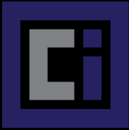







Microsoft’s contributions to the community
Dapr
CNAB
Packaging & distribution
Helm
Open Container Initiative
Virtual Kubelet
Gatekeeper
Scalability & control
KEDA
Service Mesh Interface
Kubernetes developer tooling
Draft
VS Code Kubernetes Extensions
Brigade
Notes:
SPEAKER:
There’s a rich and vibrant cloud native community, and Microsoft is in lock step building great technologies with the community. Microsoft is a contributor and leader in the community, bringing open source technologies to enterprises.
Azure is a member of the governing board and steering committee of CNCF and Kubernetes, respectively. Microsoft shares knowledge from working with diverse customers with the Kubernetes community, giving developers access to the latest Microsoft learnings and technologies, and making Kubernetes itself enterprise-friendly and easier to use.
We are also a member of the Linux Foundation board, and a platinum sponsor of the MariaDB Foundation.
Furthering our commitment to bringing the best of open source to Azure, we announced the acquisition of Citus Data – a leader in the PostgreSQL community – in January 2019.

Slide 7



Speed of innovation
Reliability
Security at scale
Notes:
SPEAKER:
How are companies developing cloud native applications in the real world. Here’re three examples of Azure customers who have realized the benefits of the cloud native approach.

Slide 8

Healthcare provider stays ahead of the competition with continuous delivery on Azure
Challenge
With numerous competitors, big and small, entering the healthcare market, we need to accelerate delivery of improved functionality and new features to our customers to stay ahead of the competition.
Outcome
Developers can quickly and easily work with their containerized applications with minimal operations and maintenance overhead, leading to shorter release cycles and helping the company achieve its desired continuous delivery approach.
Notes:
Siemens Healthineers <overview>
https://customers.microsoft.com/en-us/story/siemens-healthineers-health-provider-azure

Slide 9
“Internal and external developers can independently release microservices at any point in time, which makes development faster and enables a continuous delivery approach completely based on Azure. We have set an astonishing speed for product development. ”
Thomas Friese
Vice President, Digital Ecosystem Platform

Slide 10


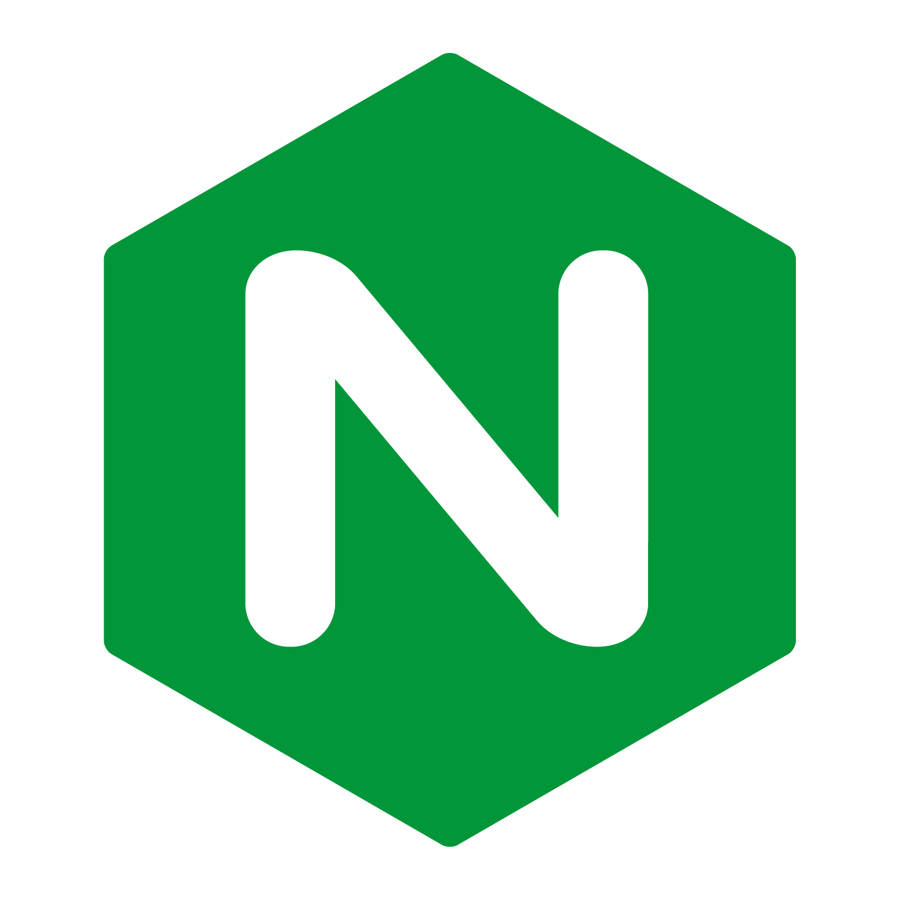







Load Balancer
Client apps
Azure Kubernetes Service (AKS)
Virtual network
NGINX Controller Frontend Ingress
External data sources
Microservices
CNCF Helm
Helm
upgrade
Azure Cosmos DB
Kubernetes
Pipelines CI/CD
Container Registry
Docker push
Docker pull
Active Directory
RBAC
Monitor
Key Vault
Notes:
https://docs.microsoft.com/en-us/azure/architecture/reference-architectures/microservices/aks

Slide 11

Retailer delivers world-class shopping experiences
Challenge
ASOS ecommerce platform needs could scale to meet seasonal demand and instant update with high reliability in any location.
Outcome Reimagined microservices architecture in a global distribution of 30 datacenters that ensures automated resiliency and high levels of performance for customers in any location. The high scalability and fast performance translated to more sales, peaking at 22 orders per second on Black Friday and 33 per second on the following Cyber Monday—the two busiest shopping days of the year.
Notes:
https://customers.microsoft.com/en-us/story/asos

Slide 12
“The service tier served 167 million requests in the 24 hours of Black Friday. We maxed at 3,500 requests a second on the product API and had an average response time of 48 milliseconds. “
Bob Strudwick
Chief Technology Officer

Slide 13








Services
Channels
Customer experience
Identity service
Customer profile SVC
DevOps
iOS
Etc.
Azure Cosmos DB
Service Bus
eCommerce
Android
Azure Kubernetes Service (AKS)
Product service
Saved items
Worker role
Worker role
Azure Functions
Table Storage
Web
Search service
Payment service
Etc.
Azure Cosmos DB
Azure Cache for Redis
Social
Stock and fulfillment
Delivery solutions
Stock
Etc.

Slide 14

Fintech developer authors innovative apps in a highly secure, collaborative environment
Challenge
Implement new product innovations on top of existing systems in a secure environment, without increasing operating costs.
Outcome
Fast and secure cloud native environment with controlled exposure powered by world-class authentication and security tools like Azure Active Directory.
Notes:
https://customers.microsoft.com/en-us/story/finastra-fusion-fabric-cloud-azure

Slide 15
“Banks can run their core system on-premise, while still managing marketplace applications on the cloud. We are facilitating their controlled exposure to the cloud, and that’s exciting.”
Félix Grévy
Global Head of Product Management

Slide 16










Pipelines
ACR
Azure Kubernetes Service (AKS)
Load Balancer External
Active Directory
Virtual Network
API Mgmt
Namespace
Namespace
…
Namespace
Load Balancer Internal
VM
VM
VM
VM
GitHub
…
Express Routes
On-prem services
Infrastructure
Azure Cosmos DB
Azure SQL Database
Log Analytics
Container Monitor
Terraform
Application Insights
Key Vault

Slide 17
























































Thousands of customers build cloud native applications on Microsoft Azure
Notes:
thousands of customers are already building and running cloud native applications on Azure.

Slide 18

Common cloud native scenarios
Modernize business critical applications
SaaS delivery
Real-time telemetry
Geo-distributed applications
Notes:
SPEAKER: there are many reasons to adopt cloud technologies, but customers often cite common scenarios that require the speed, reliability, and security that cloud-native offers include:
modernization of business-critical applications.
delivery of SaaS solutions,
real-time telemetry (from devices, cars, smart buildings, and more),
applications serving geographically-distributed users,

Slide 19










Handle spikes in demand with ease
Azure CDN
Azure File Storage
Offer customers fast and reliable service quality during seasonal and other high-traffic demand periods
Instant, elastic scaling handles traffic and sales bursts without managing infrastructures
Low-latency data access from anywhere in the world for fast, robust user experiences
High availability across multiple data centers
Azure Traffic Manager
Azure API Management
Azure Cosmos DB
Apache Spark
Device
AKS
Azure Notification Hub
Virtual nodes
Azure Functions

Slide 20

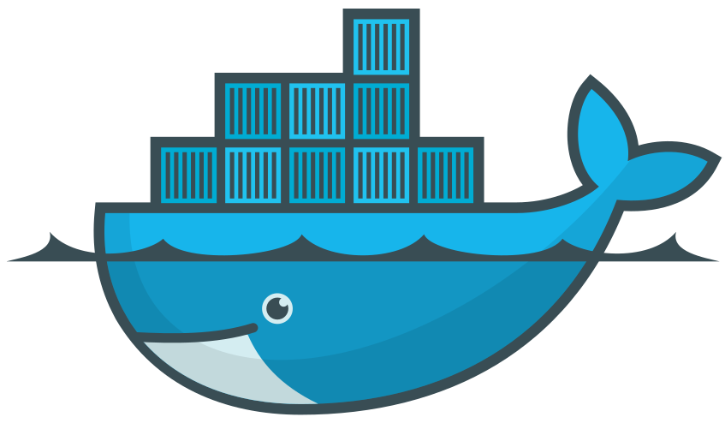

Continuous delivery of new features without downtime
Inner loop
Azure Monitor
Dev environment
AKS dev cluster
Test
Debug
App telemetry
Container health
Real-time log analytics
Unlock team agility with streamlined DevOps without compromising security
Deliver code faster with managed Kubernetes and built-in CI/CD
Accelerate the feedback loop with real-time monitoring
Balance speed and security with continuous security and deep traceability
Azure Container Registry
AKS production cluster
Source code control
Azure Policy
Container image

v1
v2
CI/CD Pipelines
Helm chart
Terraform
Release 3
Release N
Release 3
Release 2
Release
1

Slide 21



Faster customer onboarding
Azure Container Registry
Internet
Faster customer environment provisioning by changing from server-based to container- and managed service-based architecture in the cloud.
Managed container platform with built-in CI/CD pipelines to standardize the creation, update, monitoring, and scaling of prospective customer environment.
Reduce administrative overhead with auto patching, auto upgrade, and auto backup in case of outage.
Highly secure data integration with intelligent threat protection .
AKS
NGINX
Azure Pipelines
Azure Monitor
Customer A
Customer B
Customer C
Customer A
Customer B
Customer C
Java
Java
Java
Backing services
LDAP
SFTP
PRIZM
Postgres

Slide 22




Evolving to API-first SaaS business model
API
APIs running in Azure
API developers
Management portal
Azure Cosmos DB
Adapt, evolve, and allow faster innovation to turn opportunities into strategic advantages
Create API gateway and developer portal in minutes and publish APIs easily for internal or external use
Handle any data schema and adapt quickly to rapid changes
Connect to back-end services anywhere and manage, secure, and optimize all APIs in one place
AKS
API users
Developer portal
Azure SQL Database
Azure Functions
Gateway
Azure Storage
APIs running anywhere
External services

Slide 23







Azure Pipelines
Instant IoT data streaming
Azure Container Registry
Azure Web Apps
Ingest and analyze high volumes of IoT data and generate real-time recommendations and insights
Real-time data ingestion and processing pipeline capable of detection and notification within seconds
Secure API gateway that connects to back-end services running anywhere
Elastic provisioning of compute capacity without the need to manage the infrastructure
GitHub
Azure Kubernetes Service
Azure Key Vault
Azure Database for PostgreSQL
GPS and sensor
Azure API Management
Azure Databricks
Ingest service
Analysis service
Map matching service
Azure Cache for Redis
End user
mVISE
Apache Kafka on Azure HDInsights
Azure Cosmos DB
Data scientists

Slide 24







Online recommendations service HOT PATH
Real-time personalized recommendations
AKS
personalization decision engine
Azure Cosmos DB
distributed model store
Help customers discover items they’ll love with real-time personalization and product recommendations
High volumes of product data can be analyzed in milliseconds
Low-latency ensures high app performance worldwide
Tunable data consistency models for rapid insight
Product details page
Azure Data Factory scheduled job to refresh persisted models
Shoppers
Apache Spark on Azure HDInsight product and customer analytics
Event Hub customer data ingestion
Data Lake offline raw data storage
Offline recommendations service COLD PATH

Slide 25


Geo-distributed apps
Azure Cosmos DB App + session state
AKS in Region A
Put your data where your users are to give real-time access and uninterrupted service to customers anywhere in the world
Compute and data services in more regions than any cloud provider
High availability and turnkey global data replication across all Azure regions
Guaranteed low-latency experience for global users
Azure Traffic Manager
AKS in Region B
Browser
AKS in Region C
Globally distributed across regions

Slide 26



Retail
Deliver engaging digital customer experiences
Transform store management
Build an intelligent supply chain
Deliver customized offers and personalized shopper experiences in real time
Add new revenue streams faster with improved target marketing
Serverless scaling to meet seasonal demand spike
Brand ambassadors empowered by always up-to-date product catalog and inventory
Build IoT innovations that reduce errors and strengthen loss prevention
Deploy securely connected mPOS systems to reduce wait times
Close the gap between demand and fulfillment with real-time order processing and supply chain management
Expose fraud by detecting and alerting anomalies in real time
Build partner/vendor portal to improve customer service response and accuracy
Notes:
SPEAKER NOTES:
As customer expectations change, retail is being reimagined. Cloud-native apps can help to:
Deliver engaging digital customer experiences with personalization, targeted marketing, and reliable service at any scale
Transform store management with real-time product information, improved loss prevention, and mobile commerce
Build an intelligent supply chain with real-time order processing and fraud detection, and integrated customer service

Slide 27



Manufacturing & Automotive
Deliver new services
Achieve industrial IoT innovation
Enable smart, scalable supply chain management
Unlock omnichannel and personalized customer experiences
Create a collaborative development environment for partner apps marketplace
Take advantage of infrastructure advances to bring lean capabilities into IT
Ingest and analyze high volumes of IoT data and generate real-time recommendations and insights
Power smart buildings and cities
Predict equipment needs and safety issues before they happen with instant equipment diagnostics
Produce the right parts at the right time
Deploy analytics to improve quality, increase operational efficiency, and drive faster time-to-market
More effectively use computing and human resources, saving time and money
Notes:
SPEAKER NOTES:
Industry 4.0 is here, and the manufacturing and automotive sectors are taking advantage of cloud-native technologies to compete and innovate:
Deliver new services with personalization, partner collaboration, and infrastructure advances
Achieve IoT innovation with real-time insights and predictive maintenance and safety
Enable smart and scalable supply chains

Slide 28



Financial Services
Deliver differentiated customer experiences
Manage risk and detect fraud
Real-time payments
Develop services optimized for omnichannel and self-service
Speed trading and transactions with digital kiosks
Improve customer acquisitions with personalized sales and marketing
Conduct real-time analytics to stress-test risk and exceed compliance levels across standards
Expose fraud by detecting and alerting anomalies in real time
Deploy securely and confidently on-premises and in the cloud
Centralize payment pipelines to scale high volumes of payment data accurately with low latency
Enable mobile wallets for efficient use of resources
Build frictionless peer-to-peer models
Notes:
SPEAKER NOTES:
The financial services sector faces the opportunities and challenges of meeting customer expectations and offering reliability and security in a digital-first world.
Deliver differentiated experiences
Manage risk and detect fraud in real-time
Manage real-time payments

Slide 29

Microsoft Azure
Logo
Microsoft’s mission is to empower every person and every organization on the planet to achieve more.
© Copyright Microsoft Corporation. All rights reserved.
Notes:
So…let’s review.
We believe the essence of any digital transformation journey is fundamentally simple. It’s purpose is to generate value. It’s achieved by focusing on the people within your organization first and then working empower them with the right technology…enabling them to create more, do more…solve more. It’s people plus technology.
Technology is the tool
People are the focus.
And more value is the outcome.
Digital transformation is how we’re helping every person and every organization on the planet to achieve more.

Slide 30



Icons
Managed databases
DevOps
Container
Integration
Azure Pipelines
Azure SQL Database
Azure Cosmos DB
Azure API Management
AKS
GitHub
Azure Database for MySQL
Azure Database for PostgreSQL
Azure Red Hat OpenShift
Azure Logic Apps
Azure Container Registry
Azure Cache for Redis

